Slide 1

Next Hikes Internship Project User Engagement Analysis
Task 2
By
HARSHADA PATIL

Slide 2
Telco Data Analysis
Projects Contents
Top Handset and Handset Manufacturing Analysis
Top 10 Handset type & Top 3 Manufacturer
Interpretation and Recommendations
User Behaviour Analysis
Result of User Behaviour Data Frame
Non-Graphical Univariate Analysis
Graphical Univariate Analysis
Bivariate Analysis by Data Usage Category
Correlation Matrix
Decile Analysis for Total Duration
Principal Component Analysis (PCA) Results
Loadings in Principal Component Analysis (PCA)

Slide 3
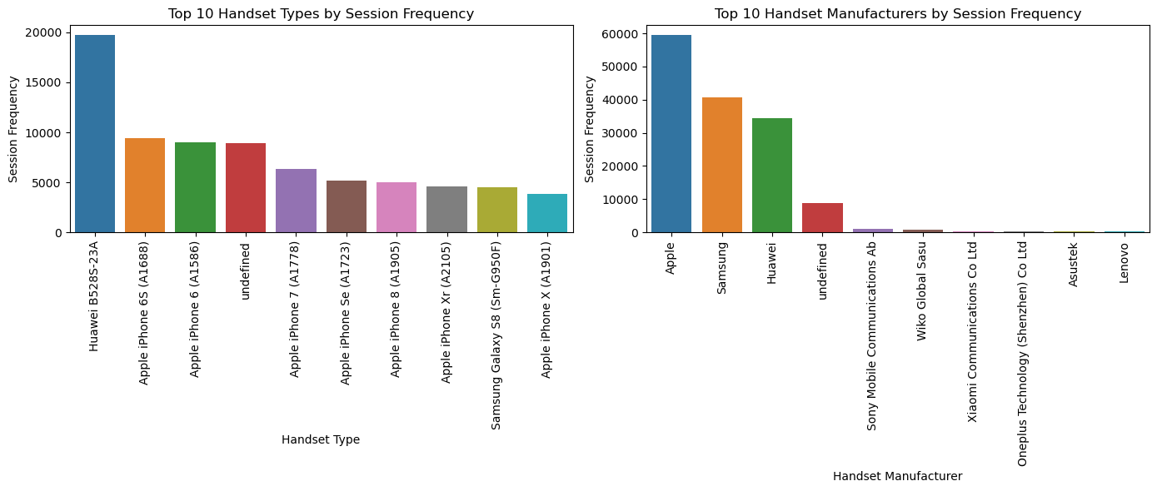
User Engagement Analysis
In telecoms provide a detailed view of a customer’s behavior, trends and usage patterns. The Telco can then use this information to tailor effective packages, offer competitive pricing, and identify ways to attract and retain customers while reducing customer churn
Sessions frequency, duration of the session, and session total traffic are key engagement metrics

Slide 4
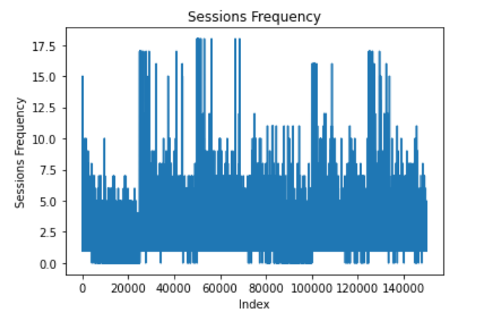
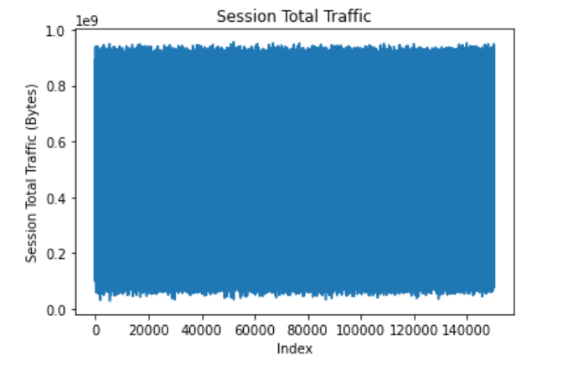
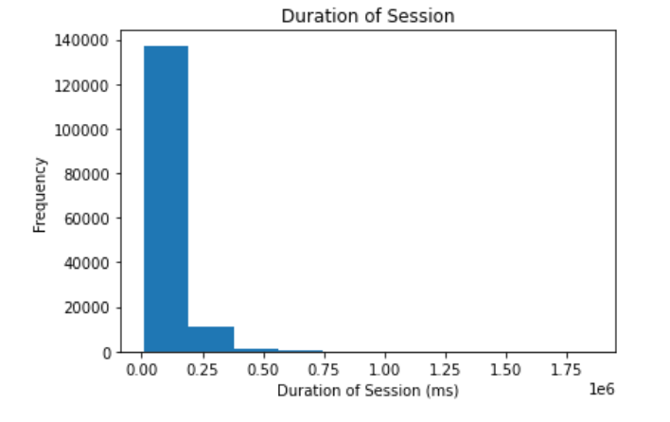
User Engagement Metrics
Users may have consistent and regular usage patterns, resulting in a relatively stable session count and duration.
The company's services or offerings may not have experienced significant changes or events that would lead to variations in session behavior.

Slide 5
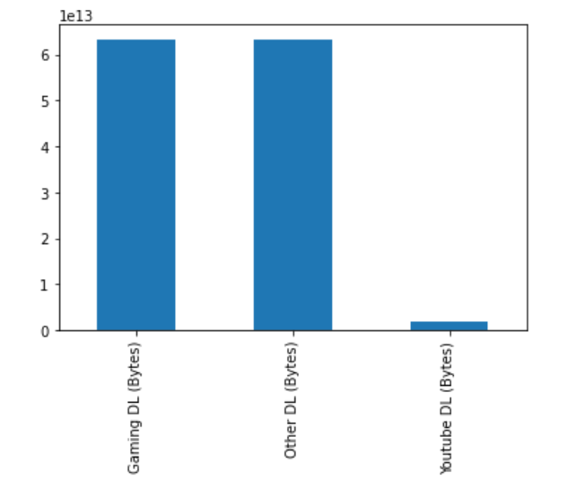
Interpretation and Recommendations
Top 3 most used app
This bar plot focuses on the top Engagement metrics with the highest data usage, both in terms of download and upload.
The x-axis represents the customers metrics and the y-axis represents the data usage .
The plot helps identify the customers where they consume the most data.
Analyzing this plot can provide insights into customer usage patterns.
Top 3 most used app

Slide 6
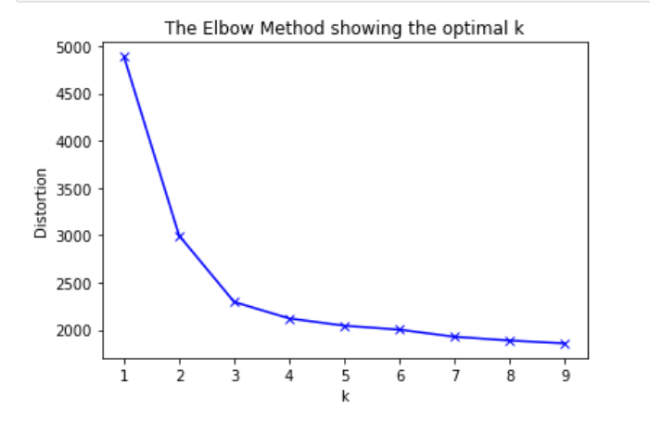
Elbow method for optimal k value
Kmeans Clustering Algorithm
A fundamental step for any unsupervised algorithm is to determine the optimal number of clusters into which the data may be clustered. Since we do not have any predefined number of clusters in unsupervised learning. We tend to use some method that can help us decide the best number of clusters. In the case of K-Means clustering, we use Elbow Method for defining the best number of clustering
What Is the Elbow Method in K-Means Clustering As we know in the k-means clustering algorithm we randomly initialize k clusters and we iteratively adjust these k clusters till these k-centroids riches in an equilibrium state. However, the main thing we do before initializing these clusters is that determine how many clusters we have to use.

Slide 7
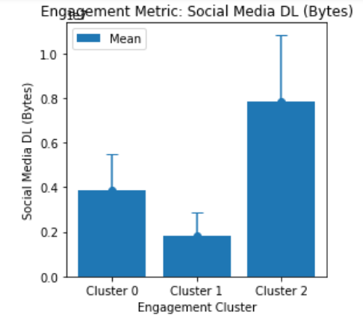
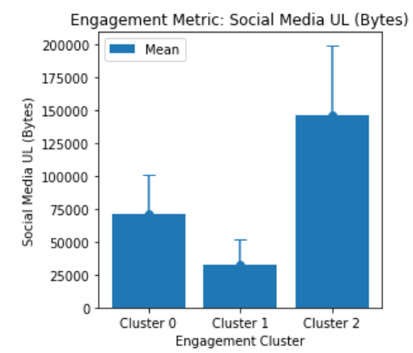
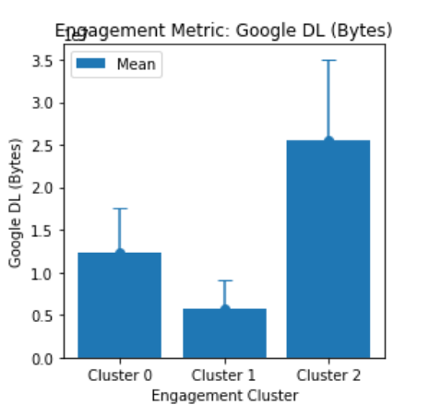
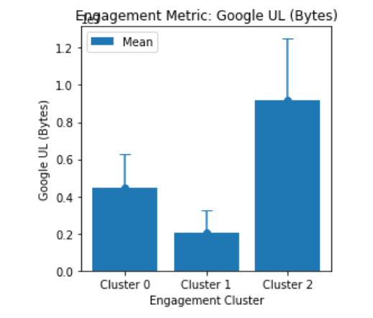
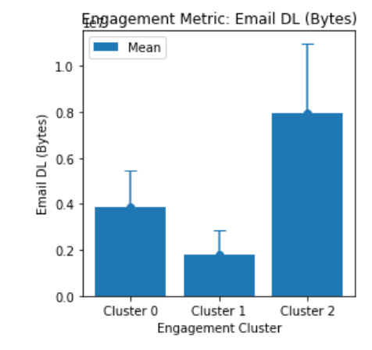
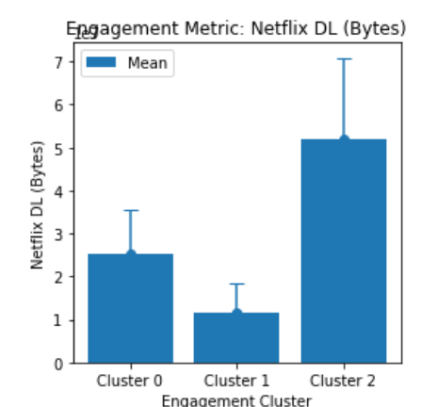
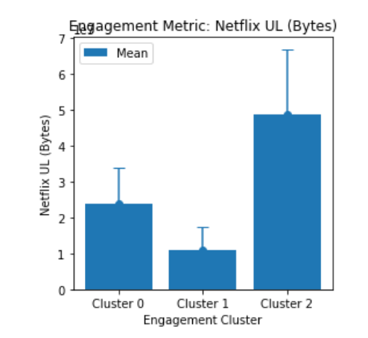
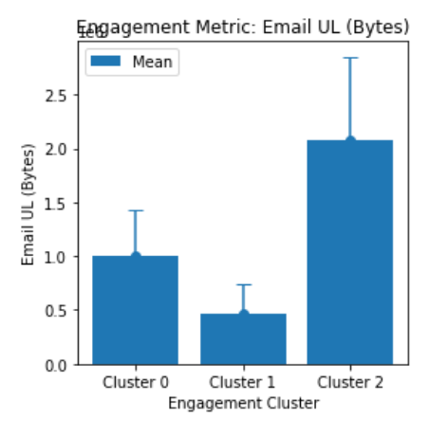
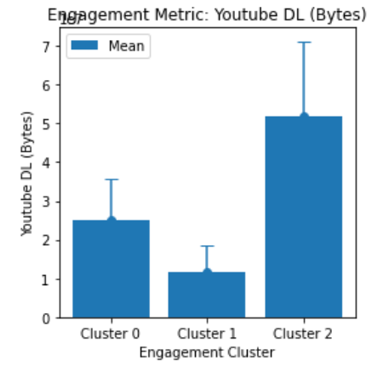
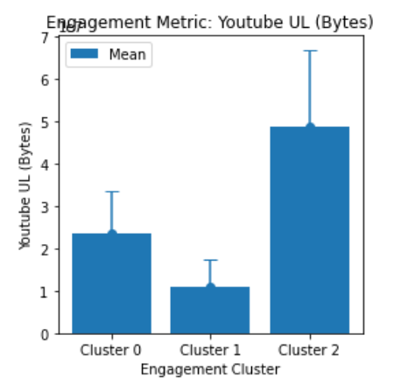
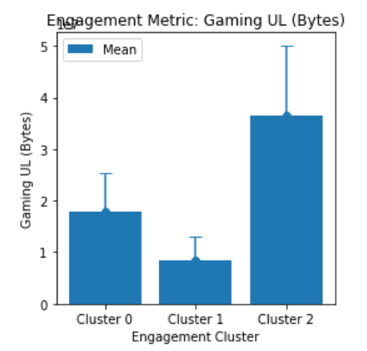
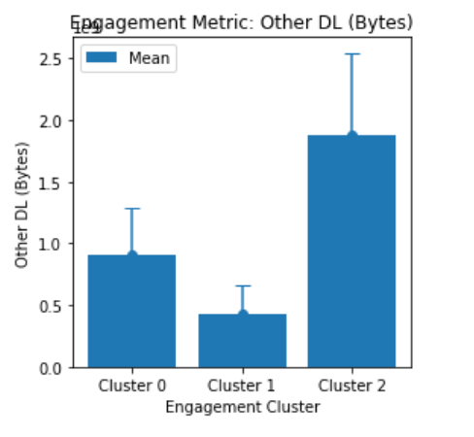

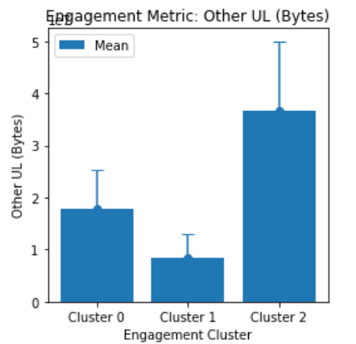
Result of clusteriong for all Engagement Metrics

Slide 8
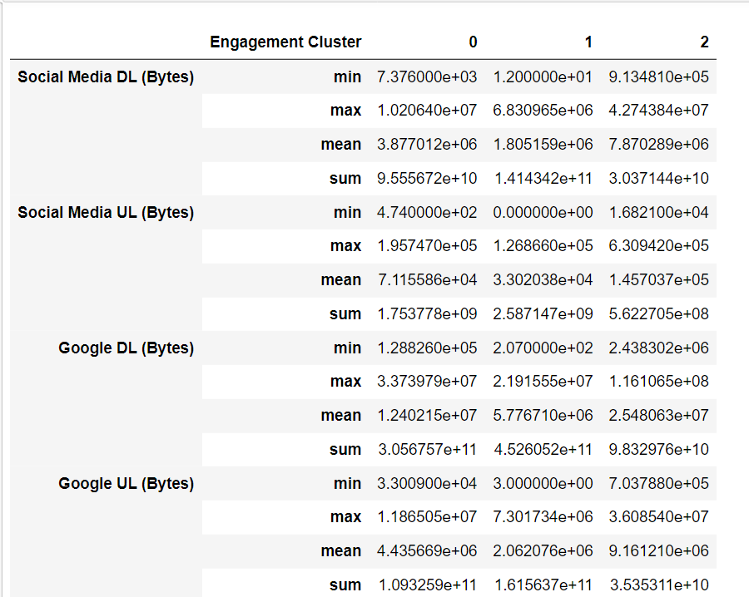
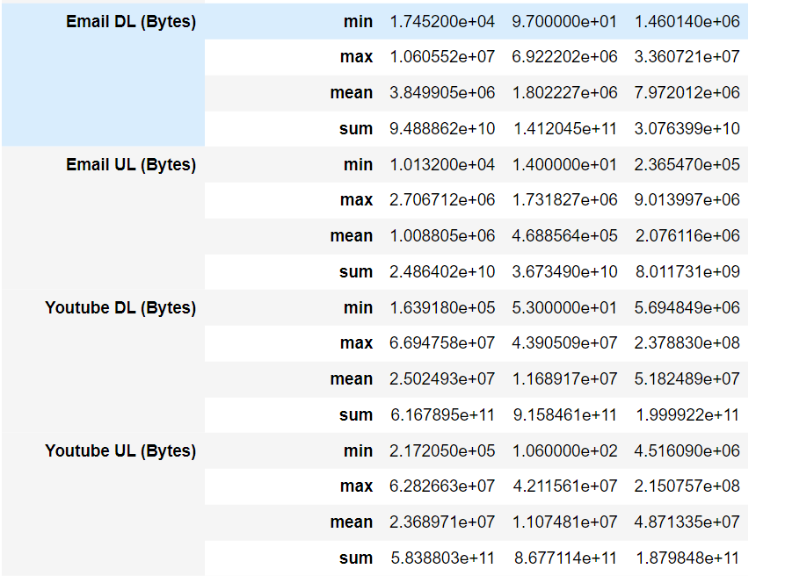
Clustering statics for each metric:
Engagement cluster 0 1 2

Slide 9
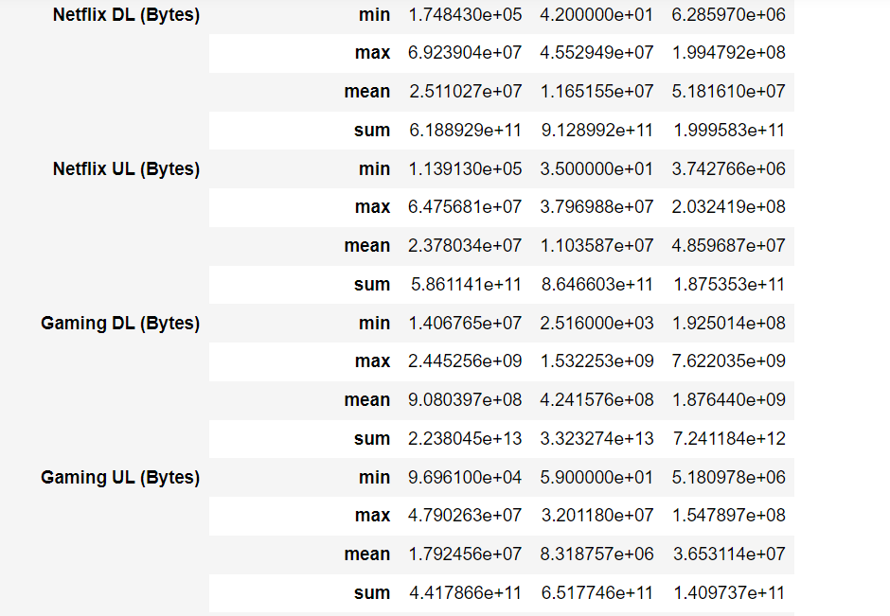
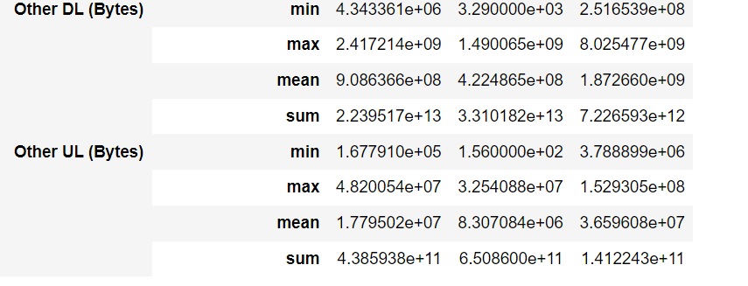
Engagement cluster 0 1 2
Engagement cluster 0 1 2

Slide 10
c
Cluster analysis is a powerful statistical technique used to group similar objects or individuals into meaningful clusters. In the context of our analysis, we applied cluster analysis to a dataset to identify distinct groups of users based on their behavior and usage patterns.
The analysis resulted in the identification of three clusters: Cluster 0, Cluster 1, and Cluster 2. Each cluster represents a unique segment of users with distinct characteristics and behaviors

Slide 11
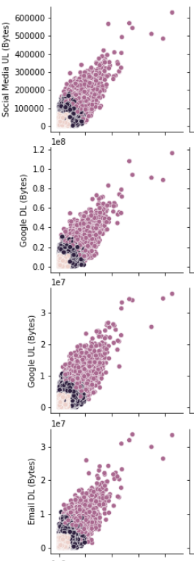
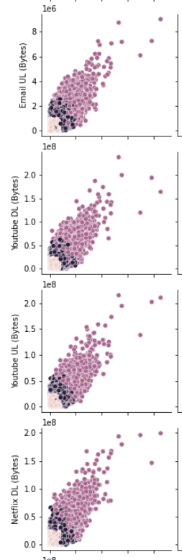
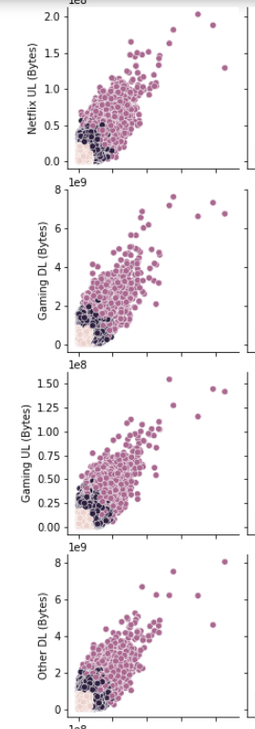
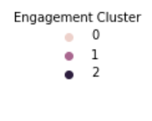
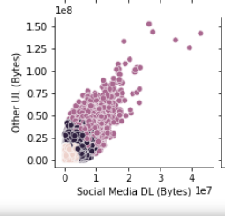
Cluster analysis

Slide 12
Thank You

